Slide 1
Detection of Parabolic Weld Defects from TOFD Scans
Roopsa Sen
2nd year, QEDM, Industrial Engineering
IIT Kharagpur
14 December 2021 - 21 December 2021

Slide 2
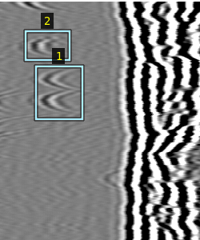
MaskRCNN model
Image size: 400X350
Total number of annotated images(with augmentation): 459 images
(3 augmented image per image, 4 scans)
Train Set: 413 images (90/10 train-validation split)
Test Images: 5
Annotation example

Slide 3
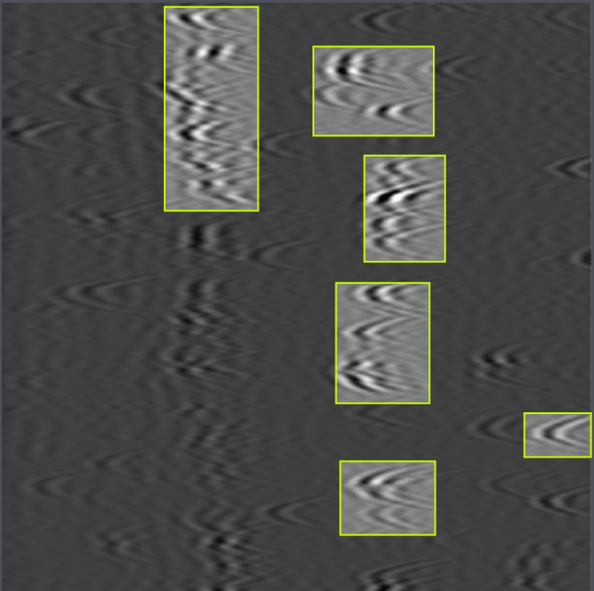
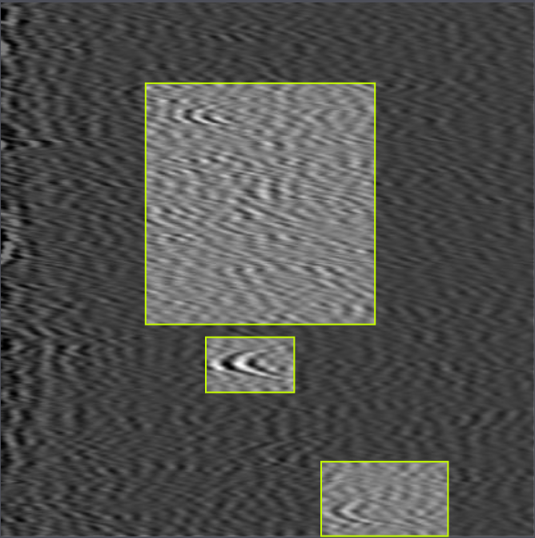
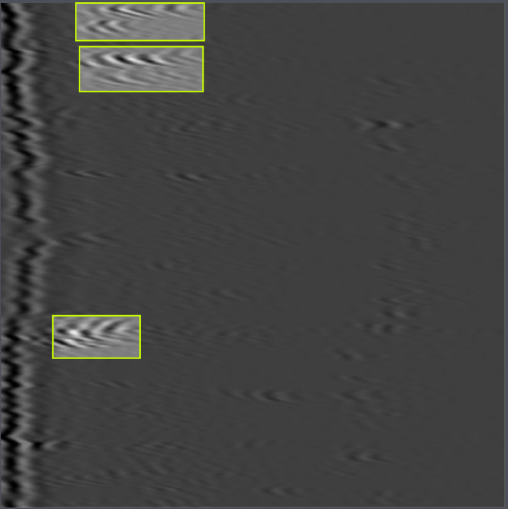
MaskRCNN results
0.61(61%) accuracy on test set, several misdetections

Slide 4
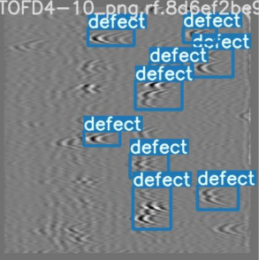
Yolo V5 model
Image size: 550X500
Total number of annotated images(with augmentation): 81 images
(3 augmented image per image, 4 scans)
Train Set: 72 images (90/10 train-validation split)
Test Images: 5
Annotation example

Slide 5
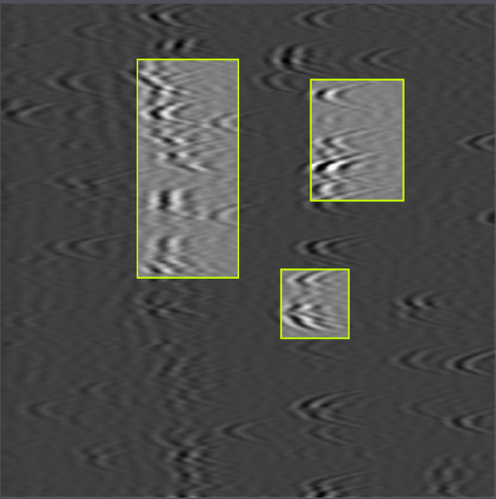
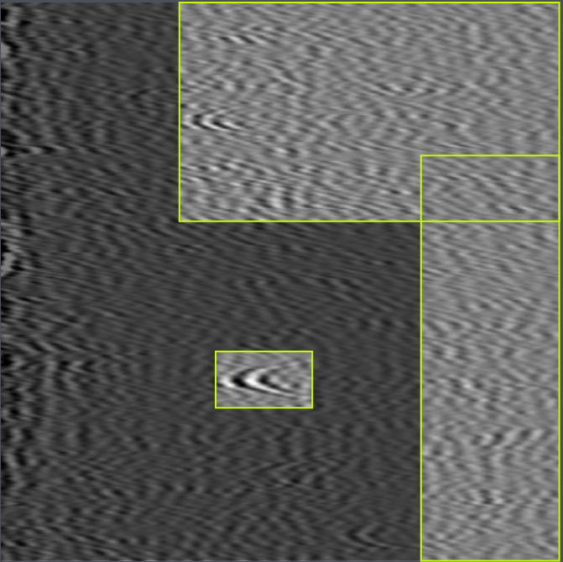
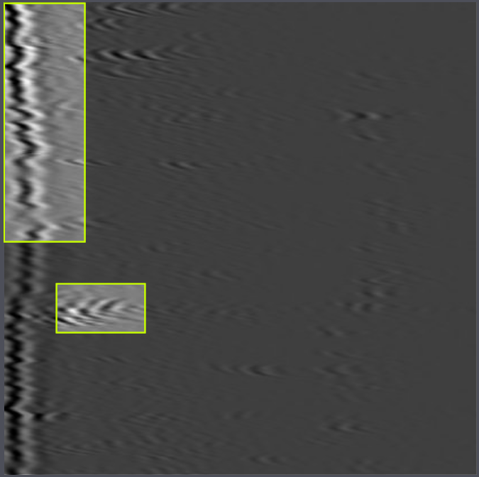
Yolo V5 results
0.56(56%) accuracy on test set

Slide 6
Next steps
Collecting more data to improve model
Improving on image processing work using area morphology or wavelet decomposition

